Slide 1

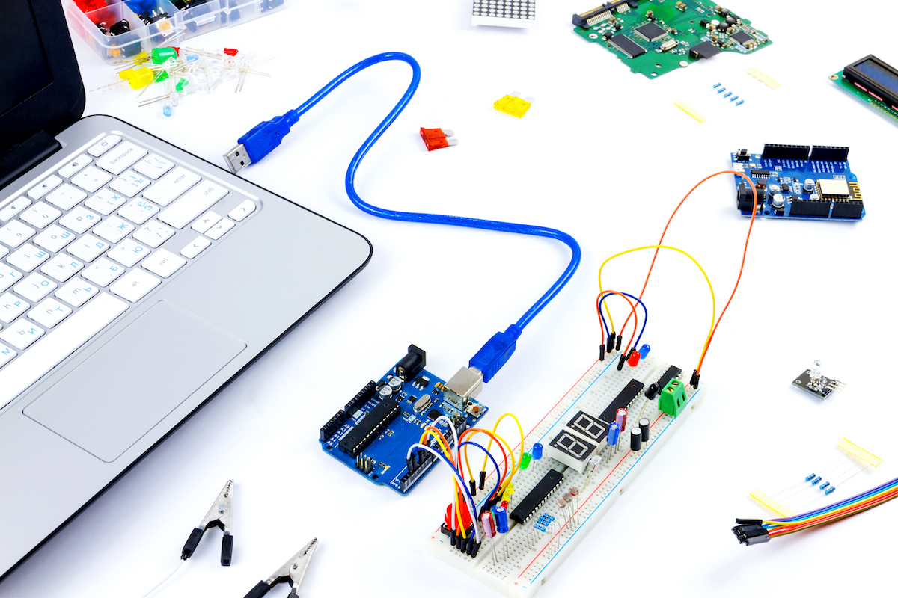
Andhra Pradesh State Skill Development Corporation
Embedded Systems
By,
B Nagaraju-APSSDC
Technical Skill Trainer

Slide 2
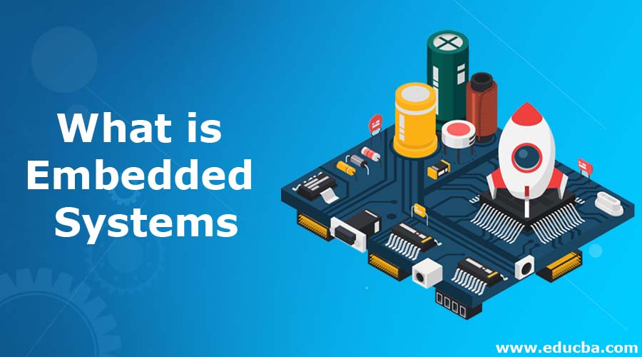

Slide 3
An embedded system is a microprocessor- or microcontroller-based system
of hardware and software designed to perform specific functions within a larger mechanical or electrical system.
or
It is a combination of both hardware and software with some mechanical parts to perform a specific task is called embedded system
Ex: printer

Slide 4
Types of processors and controllers for embedded system design
Mp/Mc
DSP
CPLD/FPGA
ASIC
SOC

Slide 5
List of companies dominating processor manufacturing
Texas instruments
Analog Devices
Intel, NVidia
Broadcom/Qualcomm/MediaTek
Microchip/NXP/Renesas
Lattice/Xilinx

Slide 6
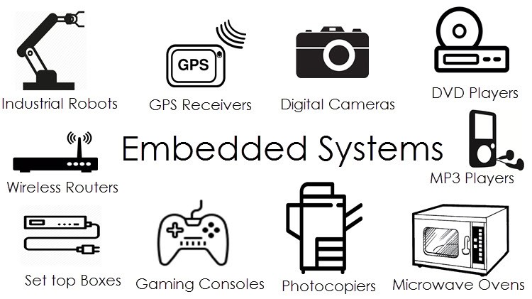
Applications :

Slide 7
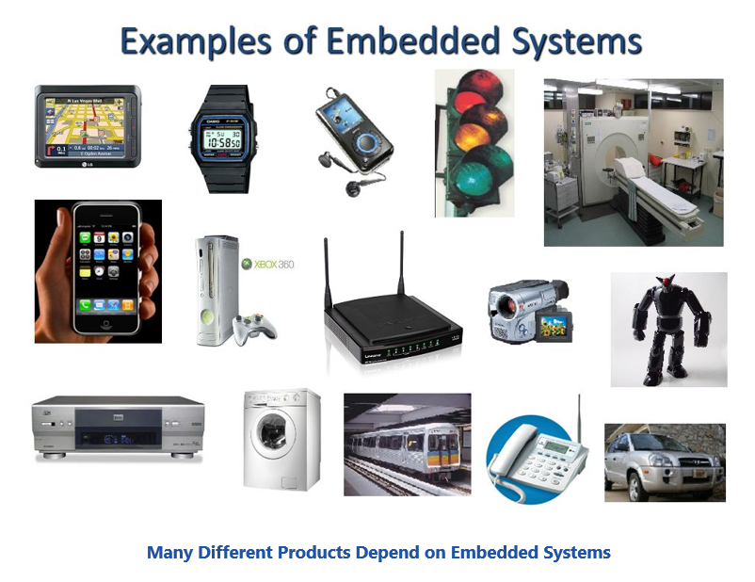

Slide 8
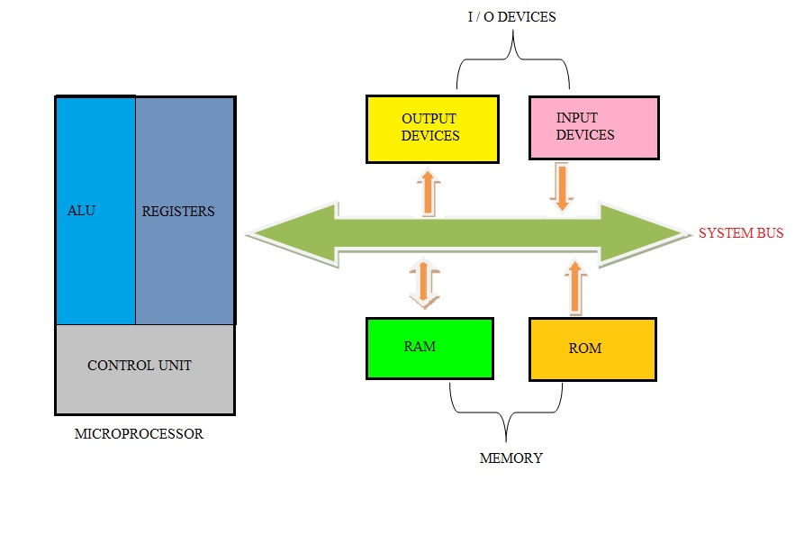
Microprocessors:
General-purpose microprocessor
CPU for Computers
No RAM, ROM, I/O on CPU chip itself
Example: Intel's x86, Motorola’s 680x0

Slide 9
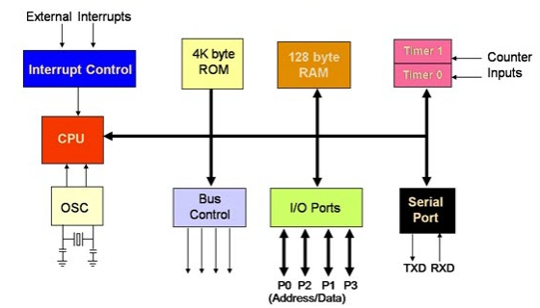
Microcontroller :
A smaller computer
On-chip RAM, ROM, I/O ports...
Example Motorola's 6811, Intel’s 8051, Zilog’s Z8 and PIC 16X

Slide 10
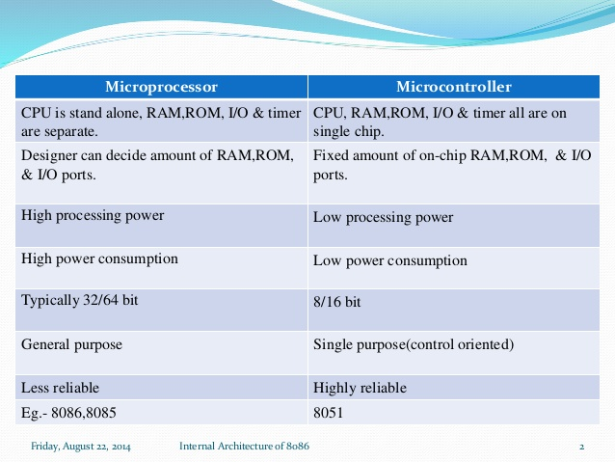
Difference Between the MP & MC

Slide 11
Introduction To 8051

Slide 12
The 8051 microcontroller was invented in 1980's by Intel.
Its foundation is based on Harvard architecture and this microcontroller was developed principally for bringing it to be used in Embedded Systems.
At first it was created by using NMOS technology but the use of NMOS consumed more power to work therefore Intel re-launch the microcontroller 8051 using CMOS technology and new edition came up with edition of letter 'C' in the title name, therefore the new modified version of microcontroller is called by name 80C51.

Slide 13
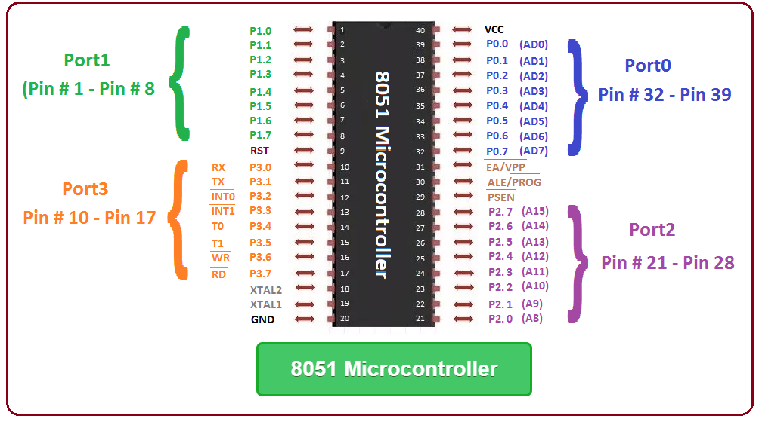
Pin Description of the 8051

Slide 14
Pins 1 to 8 − These pins are known as Port 1. It is internally pulled up, bi-directional I/O port.
Pin 9 − It is a RESET pin, which is used to reset the microcontroller to its initial values.
Pins 10 to 17 − These pins are known as Port 3. This port serves some functions like interrupts, timer input, control signals, serial communication signals RxD and TxD, etc.
Pins 18 & 19 − These pins are used for interfacing an external crystal to get the system clock.
Pin 20 − This pin provides the GND.
Pins 21 to 28 − These pins are known as Port 2.Higher order address bus signals are also multiplexed using this port.

Slide 15
Pin 29 − This is PSEN pin which stands for Program Store Enable. It is used to read a signal from the external program memory.
Pin 30 − This is EA pin which stands for External Access input. It is used to enable/disable the external memory interfacing.
Pin 31 − This is ALE pin which stands for Address Latch Enable. It is used to demultiplex the address-data signal of port.
Pins 32 to 39 − These pins are known as Port 0. It serves as I/O port. Lower order address and data bus signals are multiplexed using this port.
Pin 40 − This pin is used to provide power supply to the circuit.

Slide 16
Features of 8051 Microcontroller:
It having four register banks
64K bytes on-chip programmable memory (ROM)
128 bytes on-chip data memory (RAM)
Address bus is 16-bit unidirectional
Data bus is 8-bit bidirectional
16 bit timers
32 general purpose registers each of 8-bit
8051 microcontroller offers a number of special features such as ADC, UARTs, Op-amp, etc.

Slide 17
I/O Programming
The 8051 microcontroller programming is performed in embedded C language using Keil software.

